Slide 1
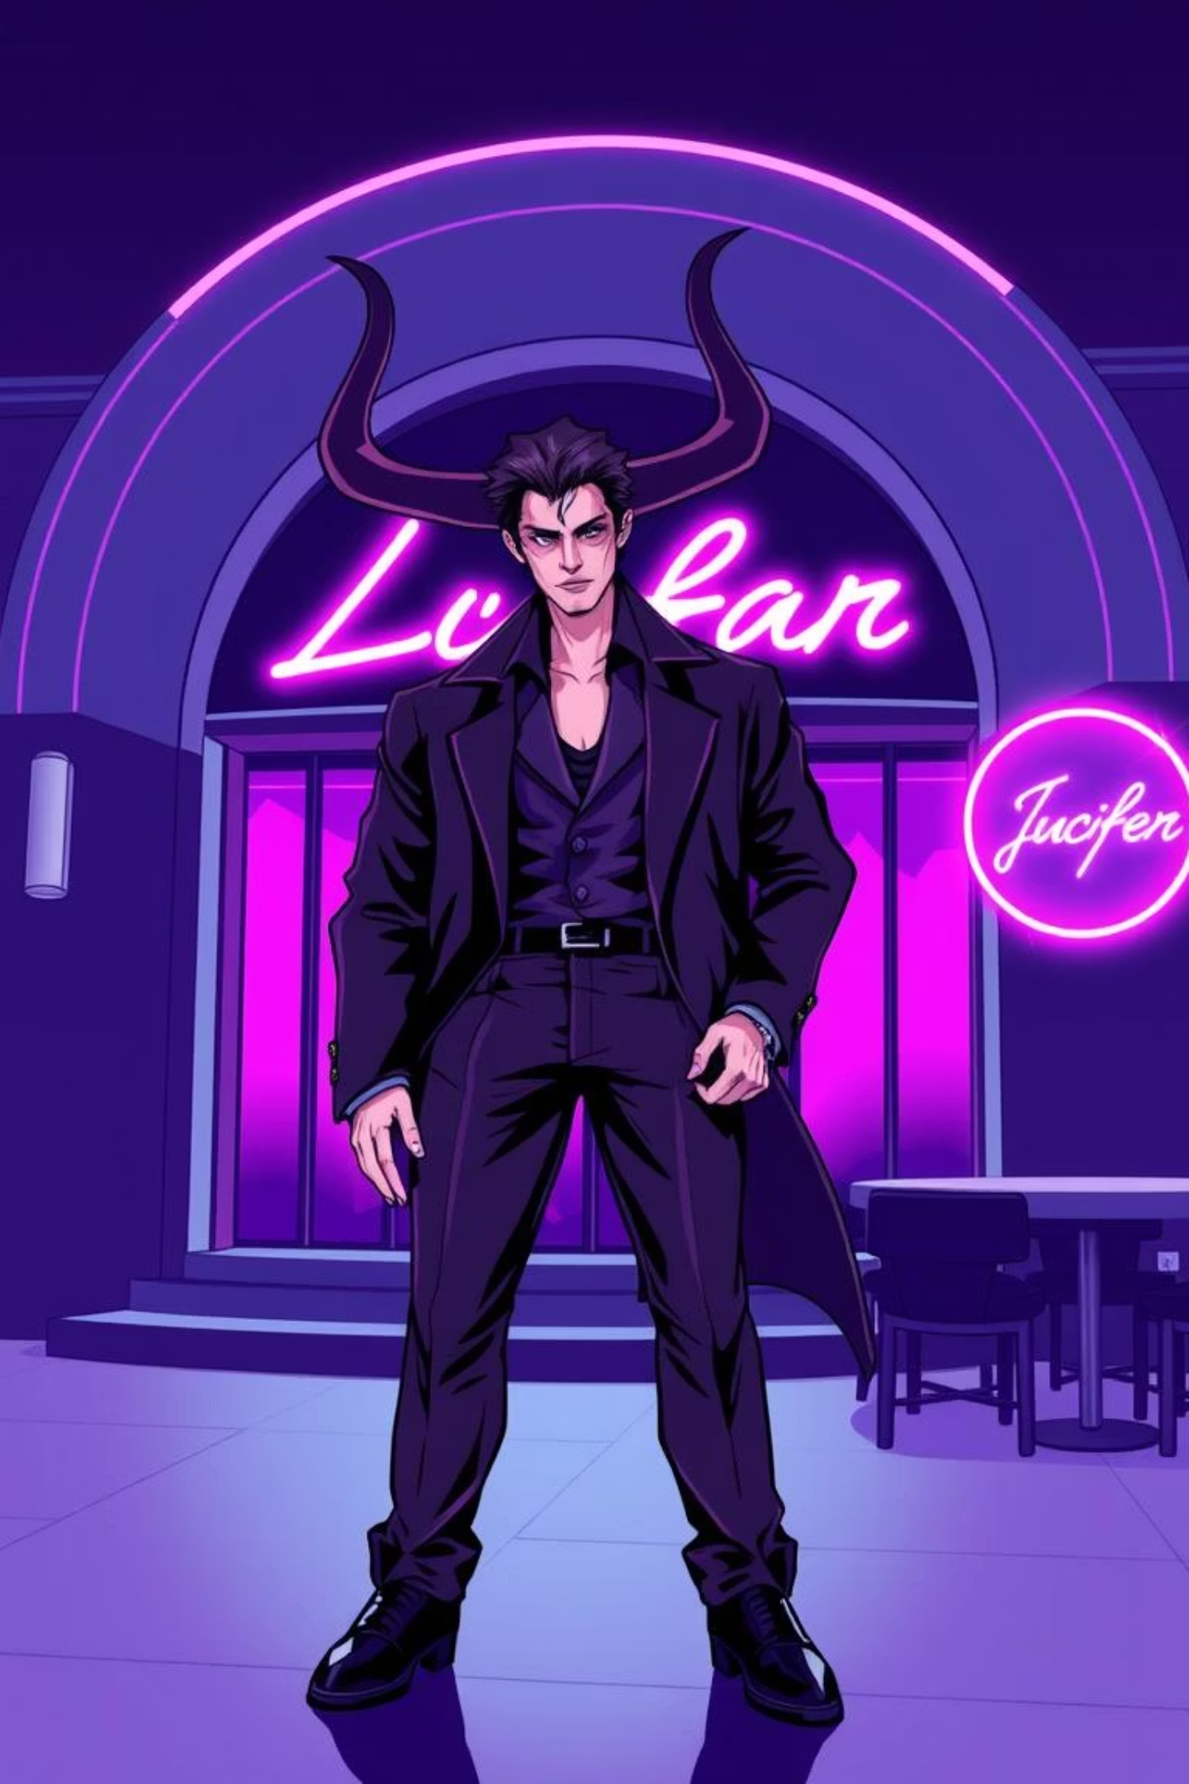
Lucifer: Character Analysis & The Devil’s Charm

Slide 2
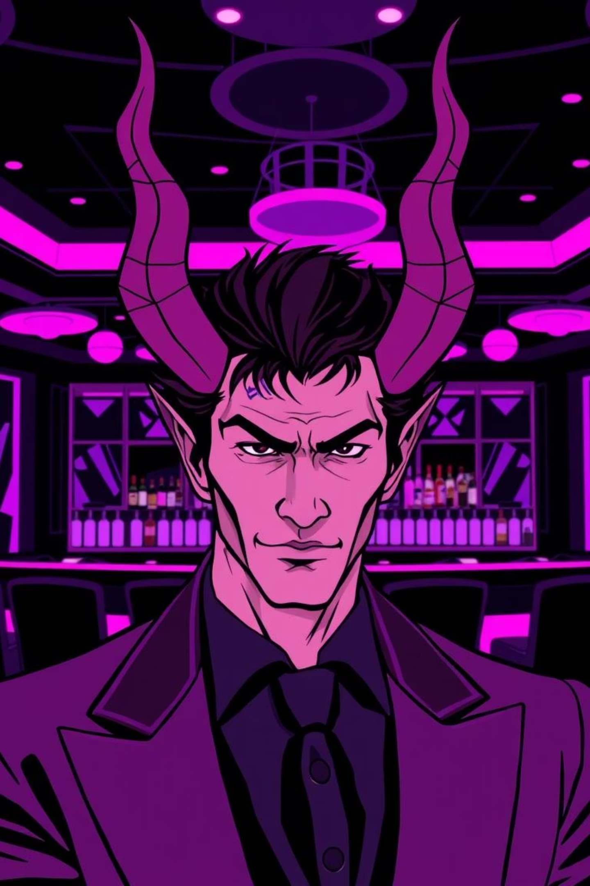
Meet Lucifer Morningstar
The Fallen Angel
Lux: A Den of Decadence
Lucifer Morningstar, who used to rule Hell, leaves his throne and moves to Los Angeles, wanting to live a life without God’s rules
He opens Lux, a fancy nightclub, which is like his own world – full of music, mystery, and secret desires, where he has fun and enjoys himself.
Complex & Charismatic
Lucifer is more than just the Devil. He is charming, clever, and complicated, always balancing his past as an angel with his life as a human.

Slide 3
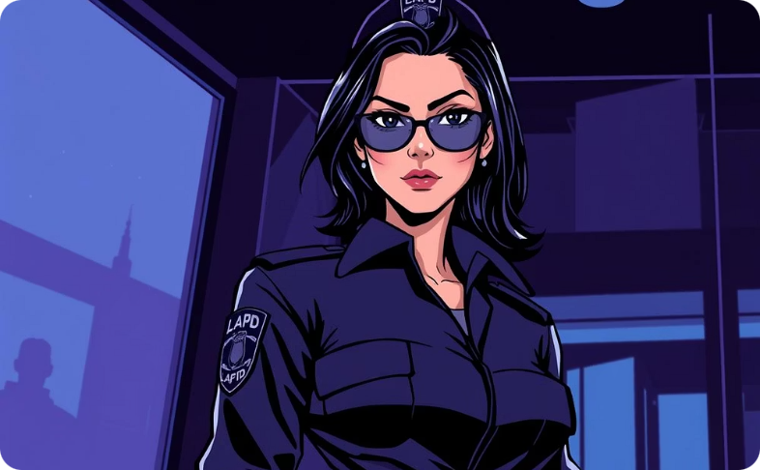
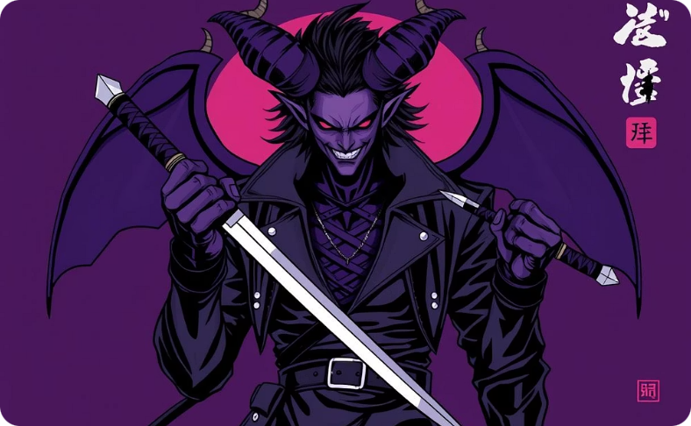
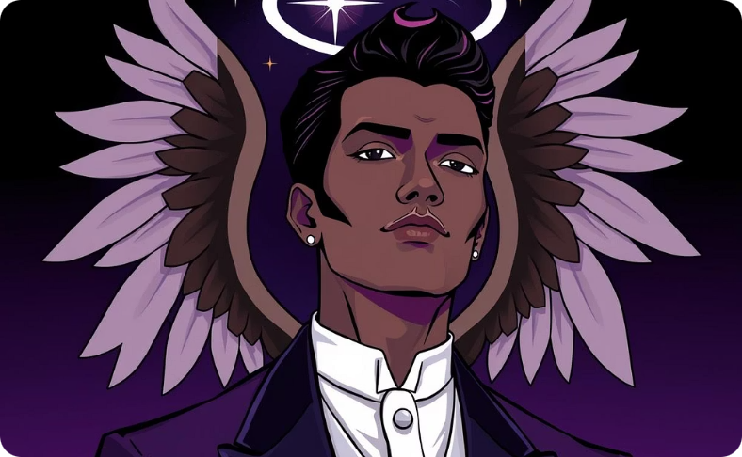
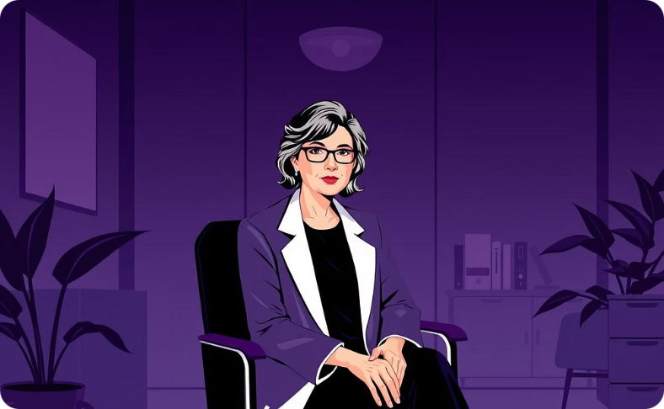
Key Characters in the Series
Chloe Decker
Mazikeen (Maze)
Amenadiel
Dr. Linda Martin
A smart LAPD detective who works with Lucifer and later becomes his main love interest. She often keeps him grounded with her practical thinking.
A strong demon and loyal friend to Lucifer. She is his bodyguard and wants to find a soul, which shapes her story.
Lucifer’s older angel brother. At first, he tries to make Lucifer go back to Hell but later struggles with loyalty and his own duties.
Lucifer’s wise therapist. Even after learning he is really the Devil, she helps him and other celestial beings with advice and guidance

Slide 4
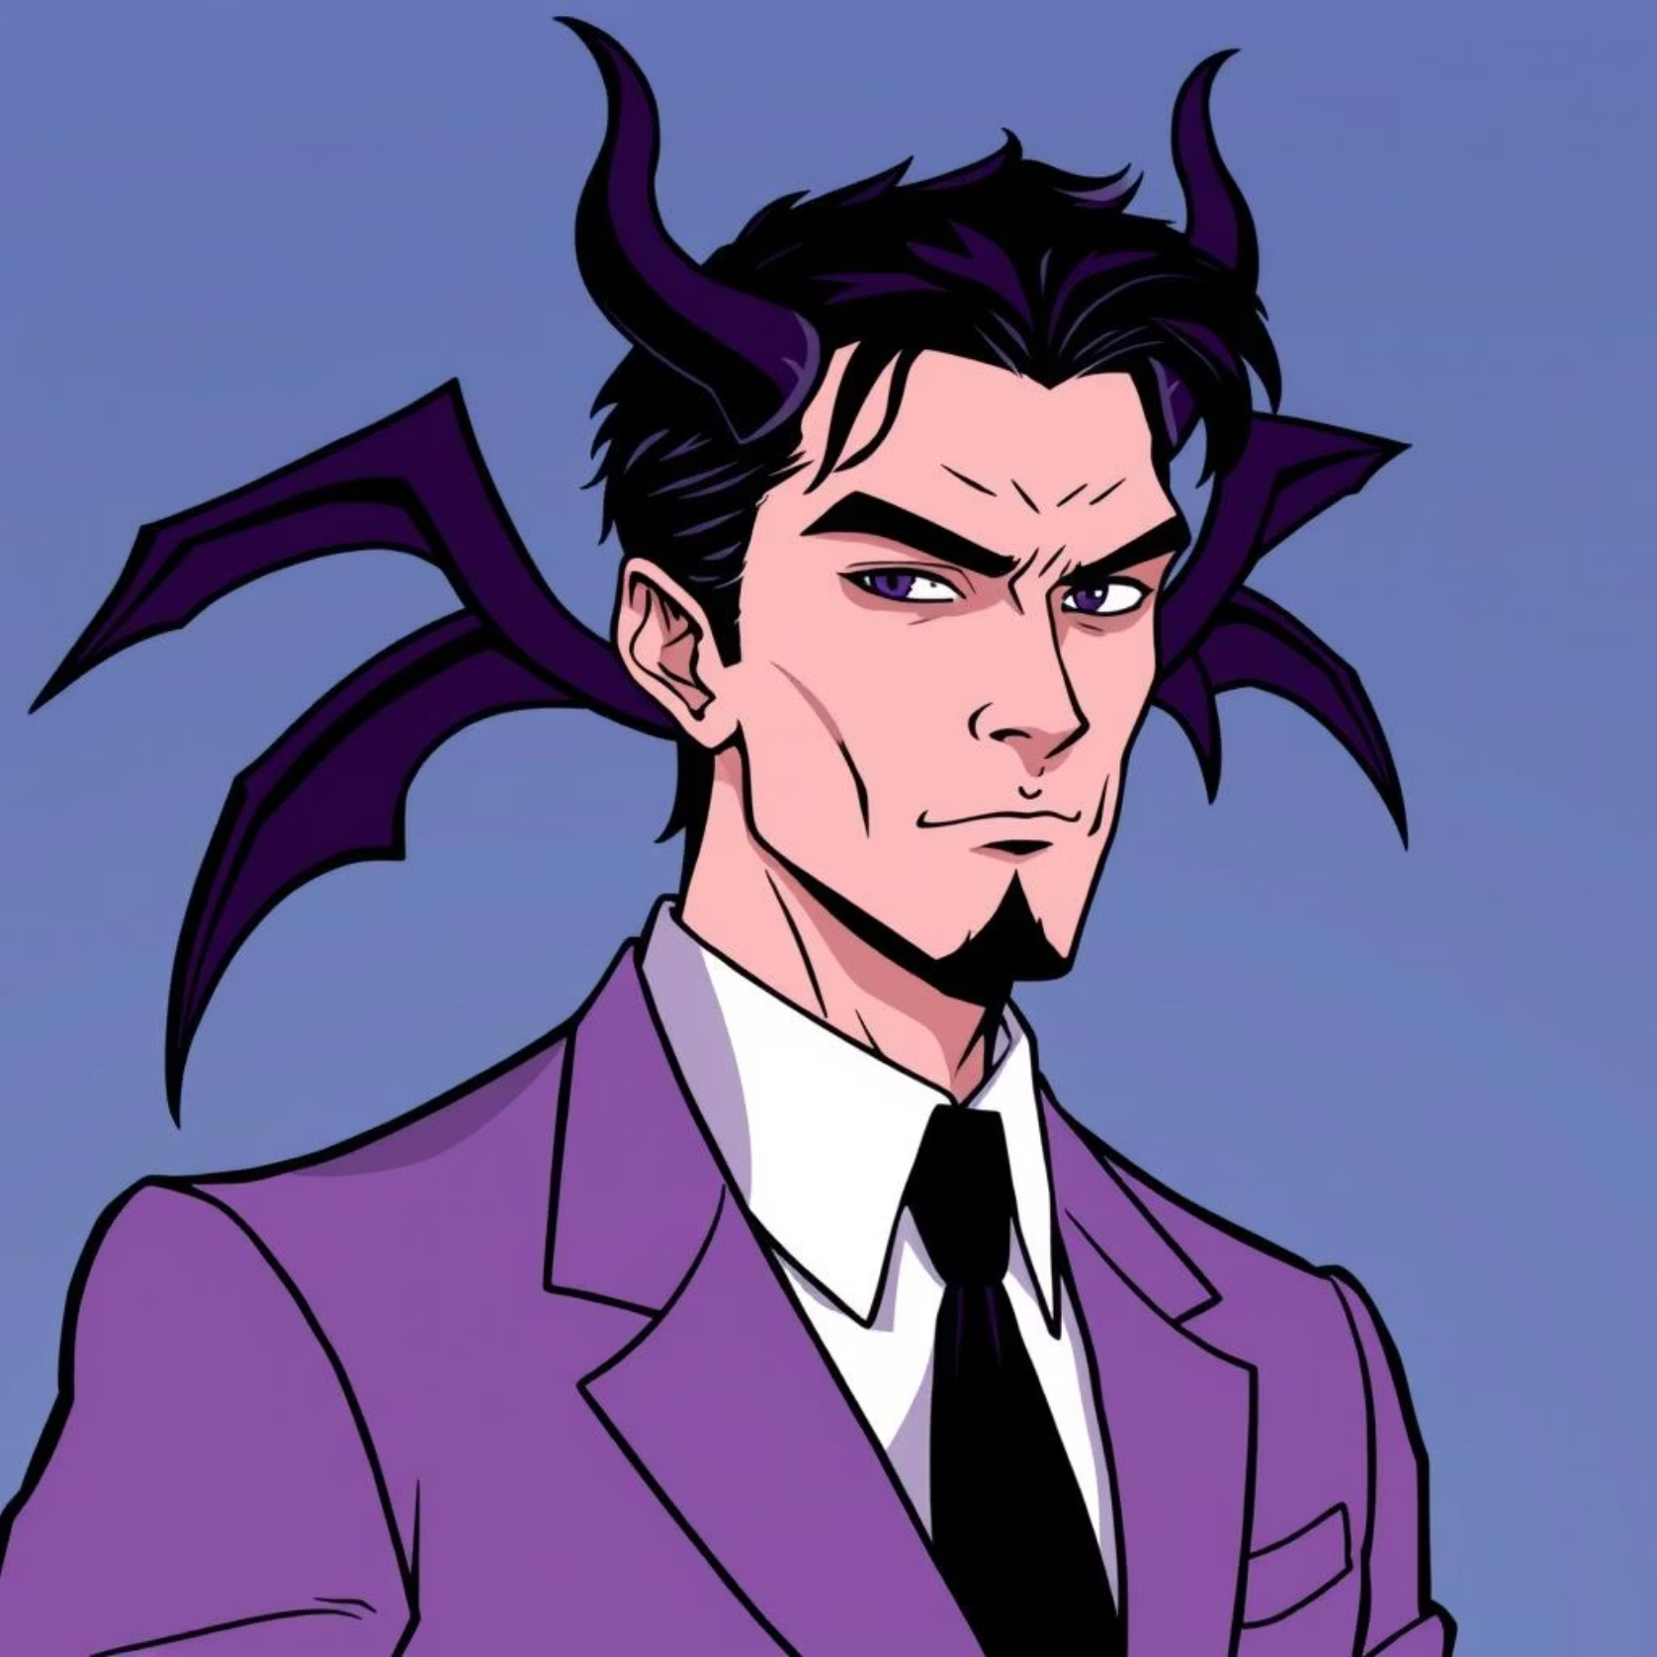



Lucifer’s Personality: Beyond the Devil Stereotype
Bold & Unapologetic
Lucifer is very confident. He acts with self-assurance and doesn’t apologize for what he wants or does.
Identity Struggles
Even though he seems brave, he often struggles with who he really is and feels misunderstood by both his family and humans.
Arrogance & Vulnerability
Lucifer is a mix of pride and kindness. He can be arrogant, but he also shows moments of weakness and care for the people he loves.

Slide 5
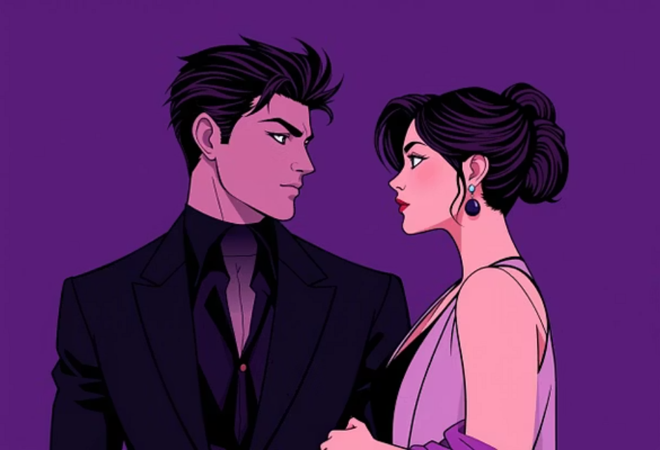
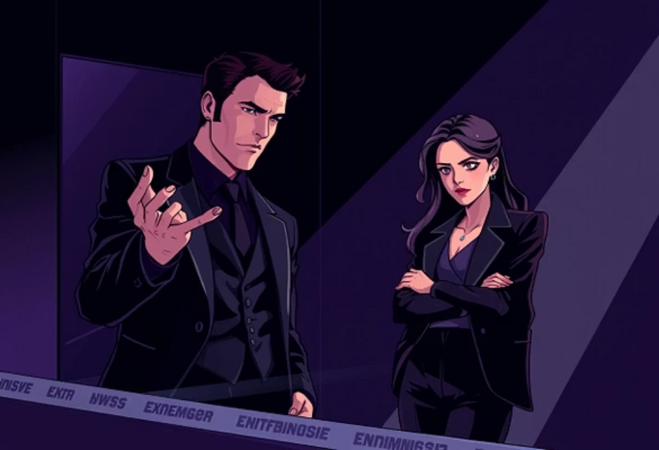


The Dynamic Duo: Lucifer & Chloe
The partnership between Lucifer and Detective Chloe Decker forms the heart of the series, evolving from professional colleagues to a deep, transformative romance.
Their partnership starts reluctantly but grows into a strong bond full of respect, support, and romantic feelings.
Chloe’s practical and fair approach balances Lucifer’s flashy and supernatural personality, making them a great team.
Their chemistry drives the story and adds emotion, keeping the audience interested in every scene they share.

Slide 6
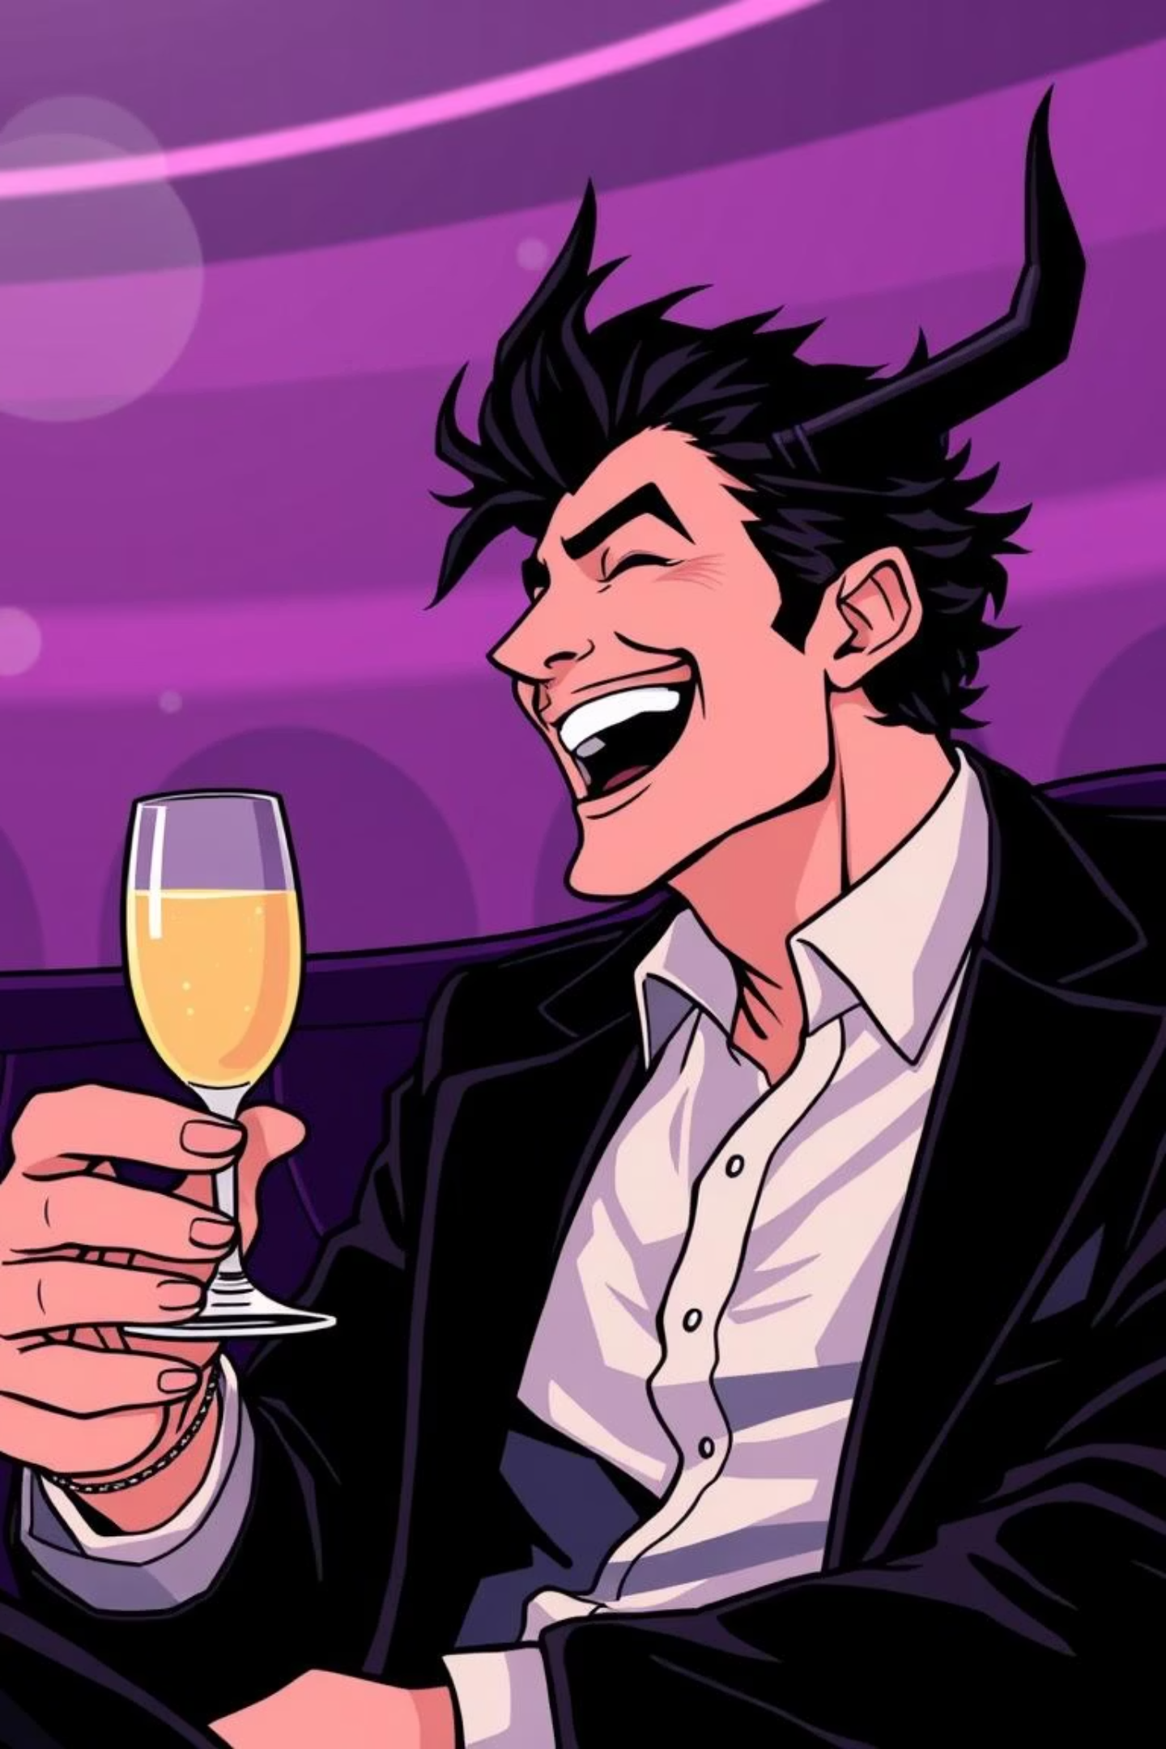



Lucifer’s Signature Humour
Sharp One-Liners
Iconic Catchphrase
Lucifer often speaks in clever, funny, or slightly cynical lines that make every scene interesting.
His famous question, “What is it you truly desire?”, helps him learn people’s true thoughts and motivations.
Disarming Charm
He uses humor to charm friends and confuse enemies, often sharing important truths in a playful way.

Slide 7
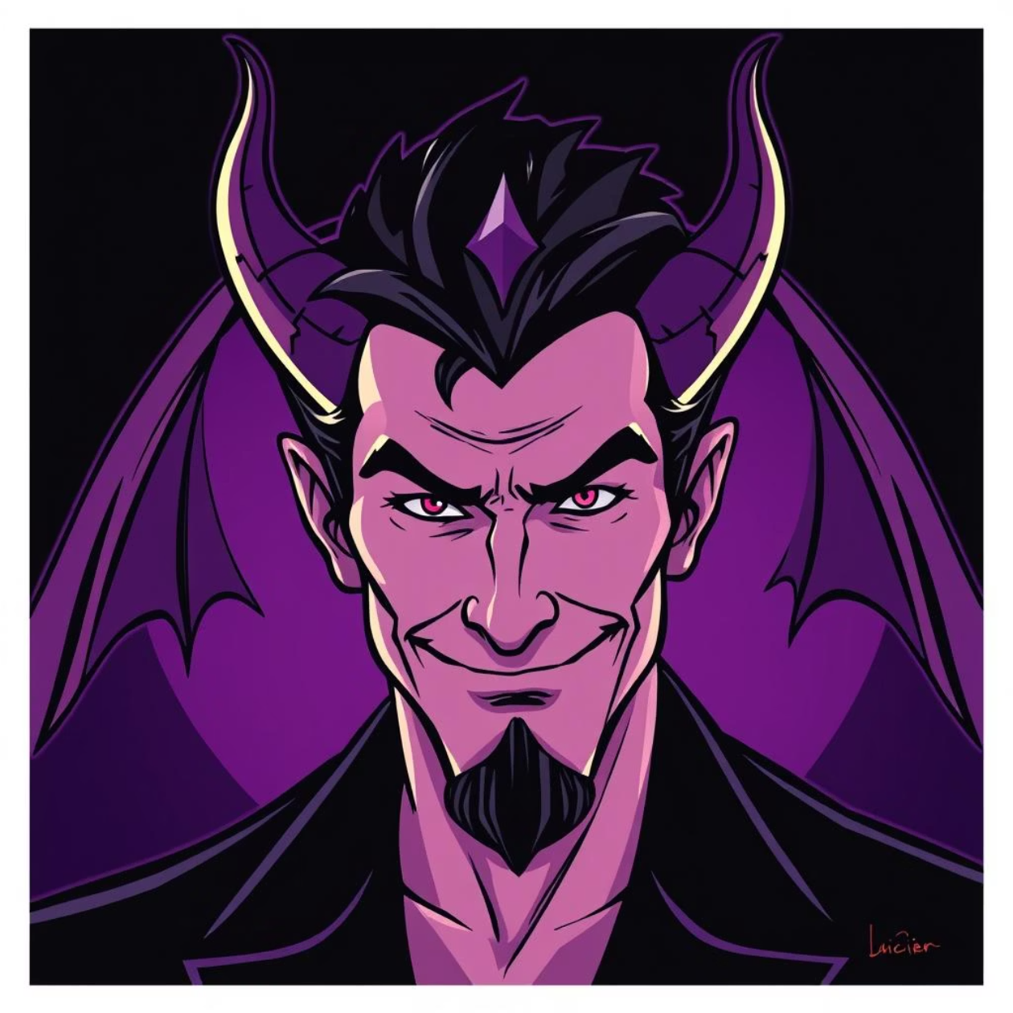
Examples of Lucifer’s Wit & Sass
The Elongated "Detective": Lucifer stretches the word “Detective” when talking to Chloe, which is funny and shows their special relationship.
"Detective Douche": Lucifer jokingly calls Dan Espinoza “Detective Douche,” which is both funny and shows his playful attitude.
Over-the-Top British Accent: He sometimes uses a British accent, making even normal lines sound dramatic and entertaining.
Sarcastic Observations: Lucifer often comments sarcastically on human behavior, pointing out their mistakes with a charming smile.

Slide 8
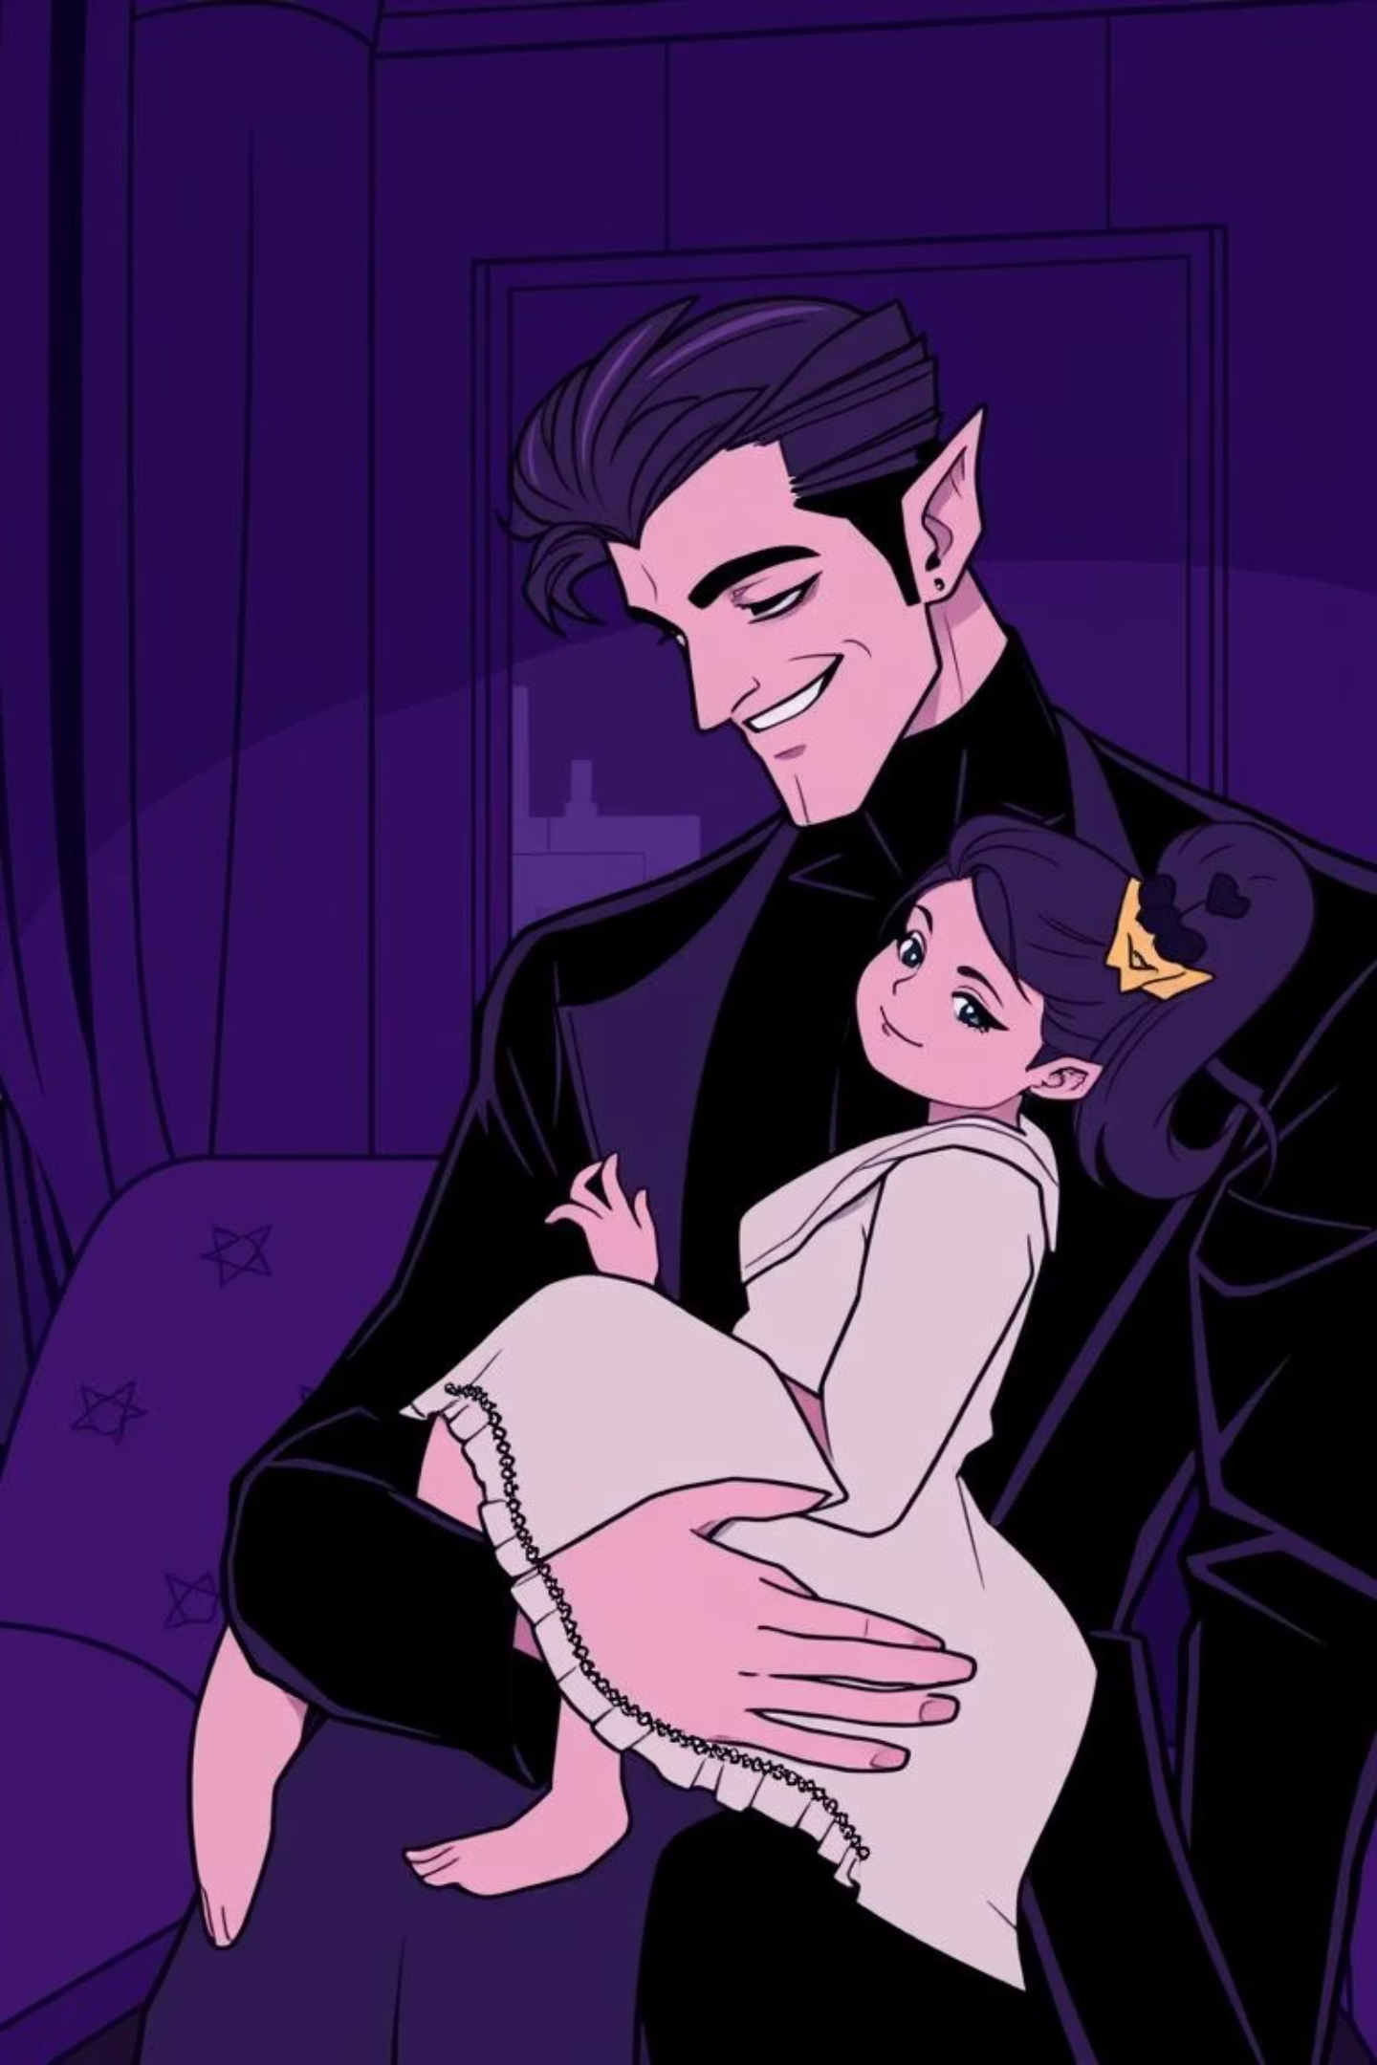
Humour Meets Heart: Lucifer’s Charm
Lucifer is charming because he mixes real emotions with his flashy humor, making him both funny and easy to relate to.
Awkward Kindness with Trixie
Grand Entrances
He loves dramatic entrances and big gestures, which make him feel larger-than-life and exciting.
Lucifer is often funny and awkward with Chloe’s daughter, Trixie, but he clearly cares, showing his softer side.
Balancing Sass & Emotion
Lucifer mixes his sarcasm and wit with moments of real emotion, showing he can feel deeply.

Slide 9
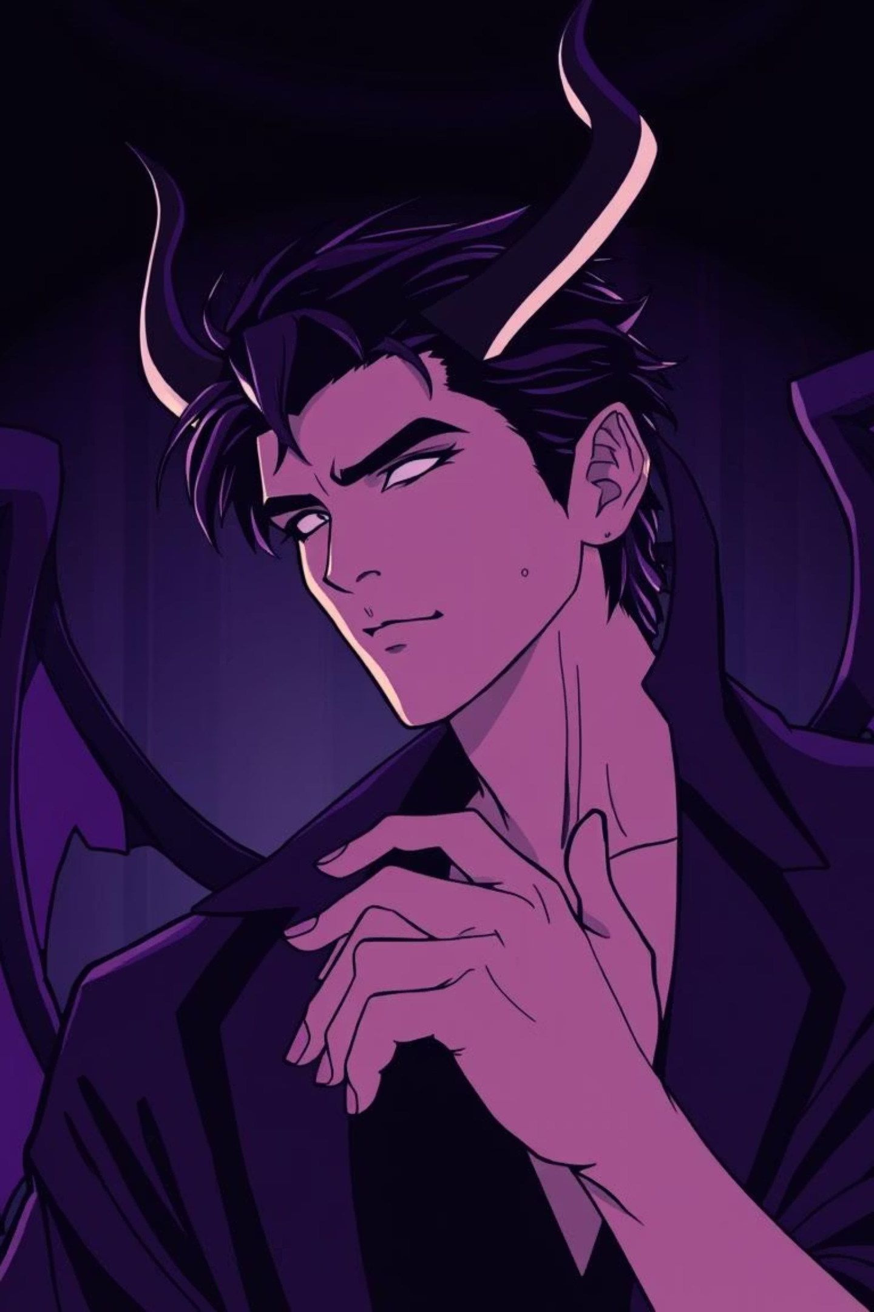
Why Lucifer’s Charisma Works
Lucifer is always interesting because he is very confident, uses humor in smart ways, and is learning more about himself.
1
2
Unapologetic Confidence
Humour as a Bridge
Lucifer is very confident and shows who he really is, even with his flaws, which people like.
He uses jokes and playful sarcasm to connect with others and make friends.
3
Complex Character Growth
Lucifer learns about himself and grows over time, showing that even the Devil can change and become better.

Slide 10
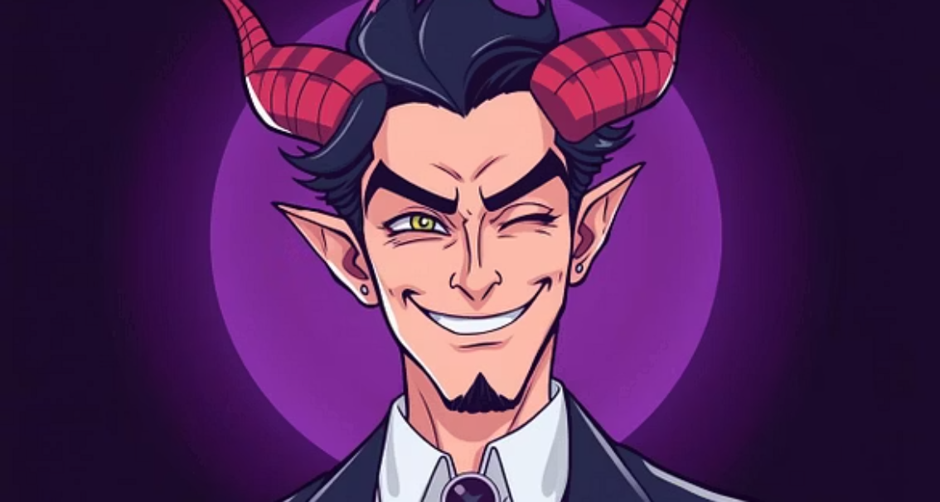
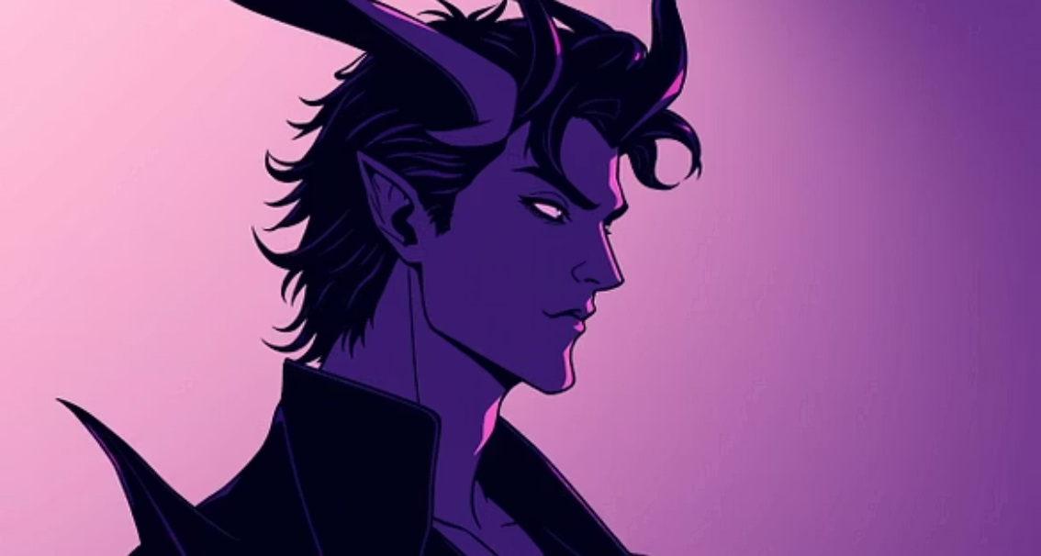
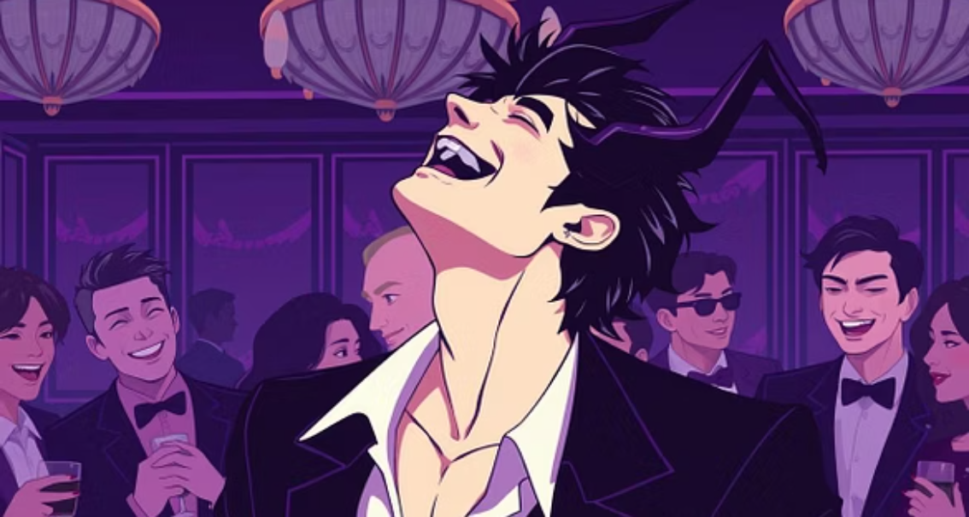
Conclusion: The Devilishly Delightful Lucifer
Lucifer Morningstar is a unique TV character who always entertains and keeps viewers interested with his many different sides.
He mixes cleverness, charm, and real emotions, making him a hero people really like.
In the end, Lucifer Morningstar is the Devil everyone can’t help but love.

